Slide 1

CHAPTER 5 Microsoft Azure Cloud Storage & Databases
|LEARNING MICROSOFT AZURE

Slide 2
Introduction to Microsoft Azure Cloud Storage and Databases
"Choosing the right database and data storage options can mean the difference between a resilient, scalable, and delightful application...and one that is not.“
Key Needs:
Access data anytime, anywhere.
Scalable storage solutions.
Data retention policies for security and compliance.
Azure’s tools help manage structured and unstructured data effectively.
Key Benefits:
Scalability: Easily upgrade storage capacity on demand.
Security: Reliable, secure data storage.
Global Access: Data accessible anywhere.
Cost Savings: No need for physical servers.
Data Synchronization: Easy sharing across devices.
Disaster Recovery: Quick data backup and restoration.

Slide 3
UNDERSTANDING DATA
Understanding Big Data:
Large volumes of complex, heterogeneous data that businesses analyze to improve strategies.
Managing this data requires specialized storage and processing techniques.
Types of Data:
Structured Data:
Organized in tables with relationships.
Examples: SQL Server, Oracle, MySQL.
Suitable for CRUD operations.
Unstructured Data:
No predefined format.
Examples: Video files, social media posts.
Best stored in NoSQL databases or Azure Data Lake.

Slide 4
Azure Storage Overview
Key Features:
Scalable and durable.
Accessible via HTTP, HTTPS, and REST API.
Offers data replication across geographic locations for disaster recovery.
Can be managed via Azure Storage Explorer.
Azure Storage Account Types:
Azure Storage v1 and v2:
Different capabilities for varied storage needs.
Choose based on your organization’s specific use case.
Tools for Managing Azure Storage
Azure PowerShell, Azure CLI for automation.
Client libraries for API development in C#, Java, Python, etc.
Azure Storage Explorer for data administration.
Scalability and Disaster Recovery with Azure Storage
Scalability: Expand storage based on demand.
Disaster Recovery: Replicate and back up data across Azure’s global data centers.

Slide 5
Azure Databases OVERVIEW
Overview:
Fully managed cloud database services.
Supports both relational (SQL) and non-relational (NoSQL) databases.
Ideal for modern cloud application development.
Structured Databases
Relational Databases:
SQL Server, Oracle, Postgres, Azure SQL.
Used for structured data requiring relationships (e.g., customer records).
Non-Structured Databases
NoSQL Databases:
Ideal for unstructured data like documents, videos, logs.
Examples: Azure Data Lake, Cosmos DB.
Use Cases for Azure Database Services
Relational Databases: Suitable for applications that need structured, transactional data.
NoSQL Databases: Ideal for handling large, diverse datasets.

Slide 6
Azure Storage Services
Cloud-based storage solutions for various types of data
Service types vary depending on data needs
Azure Storage services update frequently (refer to Azure updates)
Azure Storage Service Options
Azure Blob Storage: Massive scalable object store
Azure Files: Managed file storage with SMB and NFS
Azure Queues: Secure message storage for applications
Azure Tables: NoSQL store for structured data
Azure Managed Disks: Block-level storage for IaaS

Slide 7
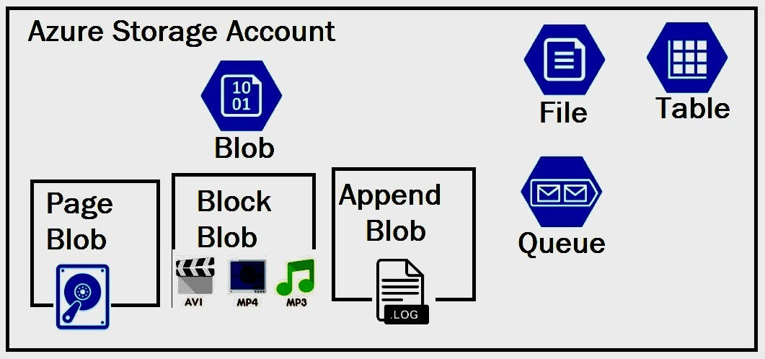
Azure Blob Storage
Cloud-based object storage for binary data (text, video, audio)
Ideal for:
Storing files for distribution
Streaming videos/audio
Backup and archiving
Azure Blob Storage Components
Storage Account: Unique namespace and URL for data objects
Containers: Organizes blobs, like folders in a file system
Blobs: Types - Block, Append, Page
Block: Text and binary data (up to 190.7 TiB)
Append: For append operations (e.g., logging)
Page: Random access files (up to 8TB)
Accessing Azure Blob Storage:
Accessible globally via HTTPS
Supported languages: .NET, Java, Python, Node.js, Ruby, PHP
Access methods: REST APIs, Azure CLI, PowerShell
For naming conventions, refer to Microsoft documentation

Slide 8
Azure Files
Managed file shares in the cloud (SMB, NFS protocols)
Accessible by cloud or on-premises deployments
SMB shares work on Windows, Linux, and macOS
Supports caching with Azure File Sync for faster access
Azure Files Use Cases and Benefits:
Replace on-premises file servers
Migrate applications to the cloud
Persistent volume for containerization
Simplify cloud development

Slide 9
Azure Queue Storage
Service for storing large numbers of messages in the cloud
Key Components:
URL Format: storageaccountname.queue.core.windows.net
Storage Account: Namespace for queue messages
Queue: Stores a set of messages
Message: Up to 64 KB in size, customizable time-to-live (TTL)

Slide 10
Azure Table Storage
NoSQL storage for large sets of structured data
Ideal for:
Handling terabytes of structured data
Easy denormalization of datasets
Fast data queries with clustered indexing
Azure Table Storage Components:
Storage Account: Required for all access
Table: Collection of entities (schema-less)
Properties: Entities have up to 252 properties
System properties: Partition key, Row key, Timestamp
Row key ensures uniqueness within a partition

Slide 11
Azure Managed Disks
Virtualized cloud storage for IaaS
Supports ultra disks, SSDs, and VM Scale Sets
Scalable and secured with high availability (99.999%)
Benefits of Azure Managed Disks
Durability: Replicated data for availability
VM Deployments: Scalable with 50,000 disks per region
Security: Role-based access control (RBAC), encryption

Slide 12
Azure SQL as a Fully Managed Service
Introduction: Azure SQL Database is a fully managed Platform-as-a-Service (PaaS) relational database.
Features:
Automatic backups, updates, and patching
Built-in high availability with 99.99% SLA
AI-powered performance recommendations
Why Choose Azure SQL?
No need for manual database management.
Optimized for cloud applications with elastic scaling.

Slide 13
Azure SQL Deployment Options
SQL Server on Azure Virtual Machines (VMs): Full control over SQL Server instance for lift-and-shift scenarios.
SQL Managed Instance: Near 100% compatibility with on-prem SQL Server, with cloud-native features.
SQL Database: Fully abstracted serverless model with Hyperscale and autoscaling for cloud-native apps.

Slide 14
SQL Server on Azure Virtual Machines (IaaS)
This option allows businesses to run SQL Server on Azure VMs
suitable for those already familiar with SQL Server.
Azure manages security patches and backups
users are responsible for maintaining the OS and SQL Server software.

Slide 15
SQL Managed Instance (PaaS)
Offers most SQL Server features without needing to manage virtual machines.
This is ideal for businesses looking to save on infrastructure costs while retaining SQL Server’s instance-scoped features.

Slide 16
SQL Database (PaaS)
Abstracts the server management completely.
Allows businesses to focus purely on application development.
Supports hyperscale for large storage.
Supports geo-replication for global reach.
Supports autoscaling for unpredictable workloads.
Offers a high availability SLA and intelligent performance management.

Slide 17
Azure Cosmos DB: Global No-SQL Database
Description: Azure Cosmos DB is a globally distributed, fully managed NoSQL database service.
Global Scale: Geo-replication enables distribution of data across multiple Azure regions.
Multi-Model Support: Supports document, key-value, graph, and column-family data models.
Performance: Single-digit millisecond latency and 99.999% availability for multi-region deployments.

Slide 18
Benefits of Azure Cosmos DB
Scalability: Elastic scaling of throughput and storage based on demand.
Global Distribution: Automatic replication to any Azure region for global access.
High Availability: 99.999% availability with multi-region replication and disaster recovery.
Flexible Consistency Models: Five well-defined consistency levels from strong to eventual consistency.

Slide 19
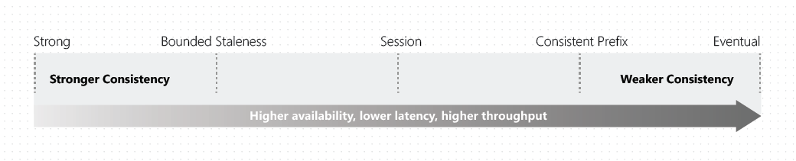
Consistency Levels in Cosmos DB
Strong Consistency: Linearizability for the most recent committed writes.
Bounded Staleness: Reads lag behind writes by a defined period or versions.
Session Consistency: Ensures monotonic reads and writes within a session, great for user-specific data.
Consistent Prefix: No out-of-order reads.
Eventual Consistency: Lowest latency but no up-to-date reads guarantee.

Slide 20
Cosmos DB APIs
Core (SQL) API:
For document-based data with SQL syntax queries
Ideal for migrating from traditional databases like Oracle or DynamoDB.
Gremlin API:
For graph-based data, useful for complex relationships, such as social networks or IoT data.
MongoDB API:
Enables use of existing MongoDB applications with minimal changes.
Cassandra API:
Supports column-oriented data storage and scales horizontally for large datasets.
Table API:
A key-value store that works well with OLTP scenarios
Can migrate from Azure Table Storage with minimal effort.

Slide 21
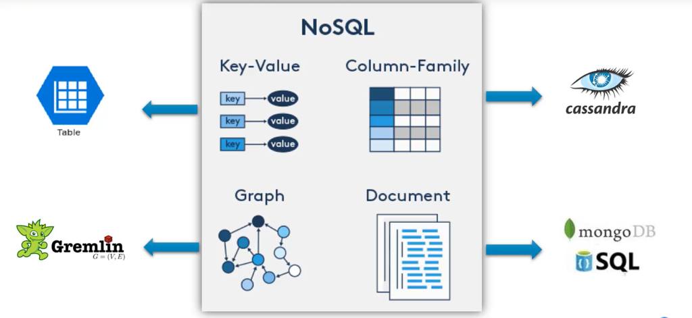
COSMOS DB APIS

Slide 22
Global Distribution and Replication in Cosmos DB
Elastic Global Scale: Distribute data automatically across multiple regions for low-latency access.
Multi-Homing: Data available in every region, apps access nearest region automatically.
Region Changes: Region changes handled without app interruption, with multi-region writes for enhanced availability.

